Slide 1
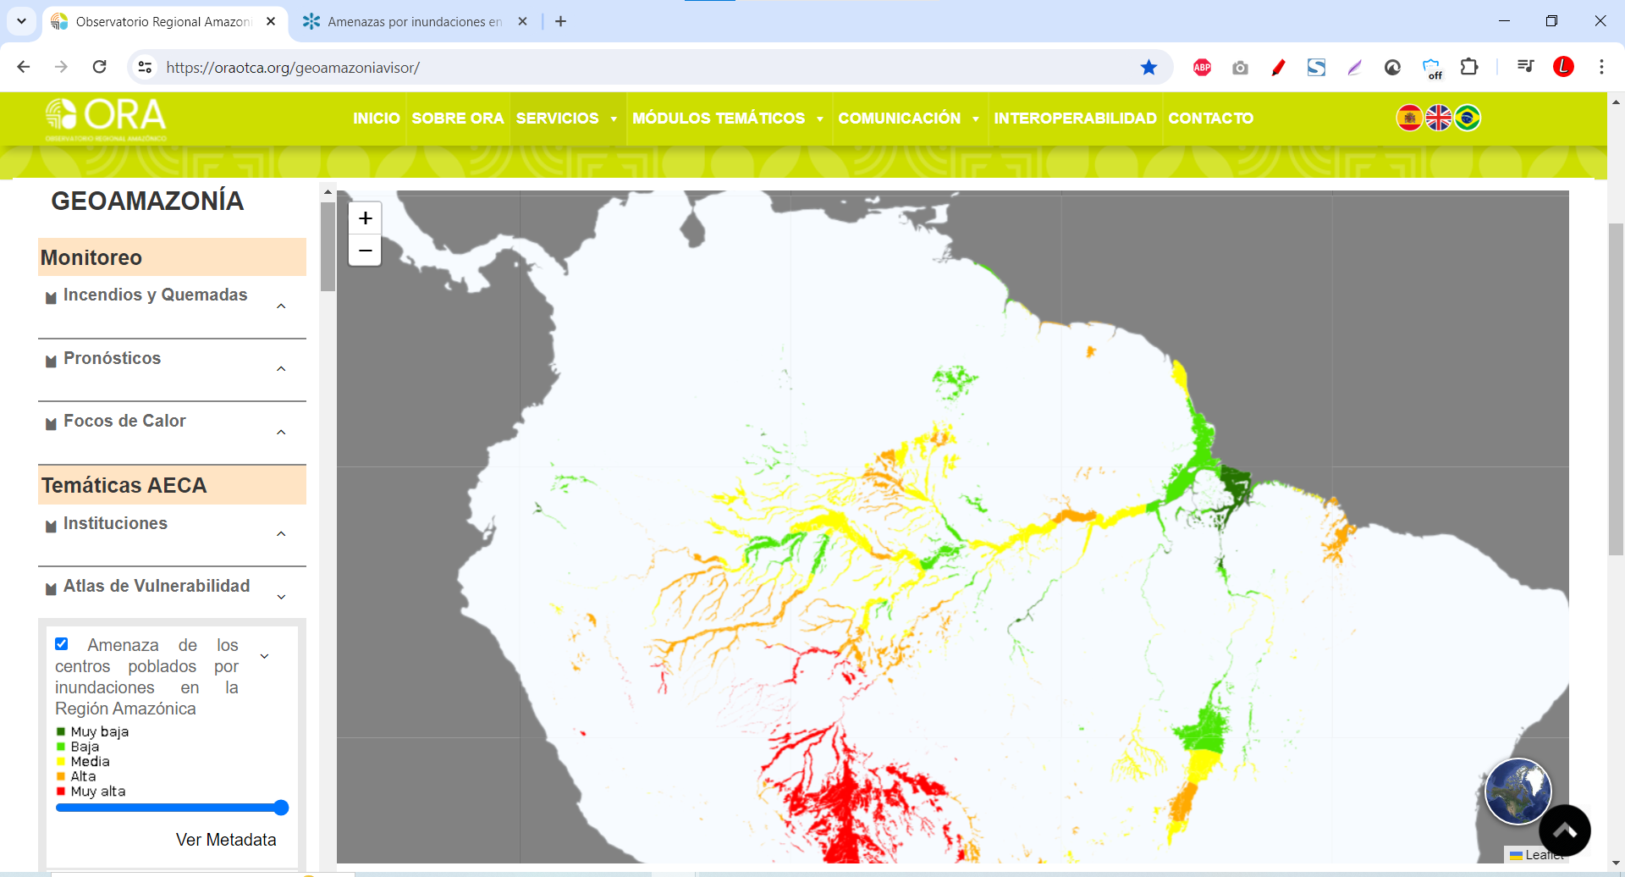
https://oraotca.org/geoamazoniavisor/
1
2

Slide 2
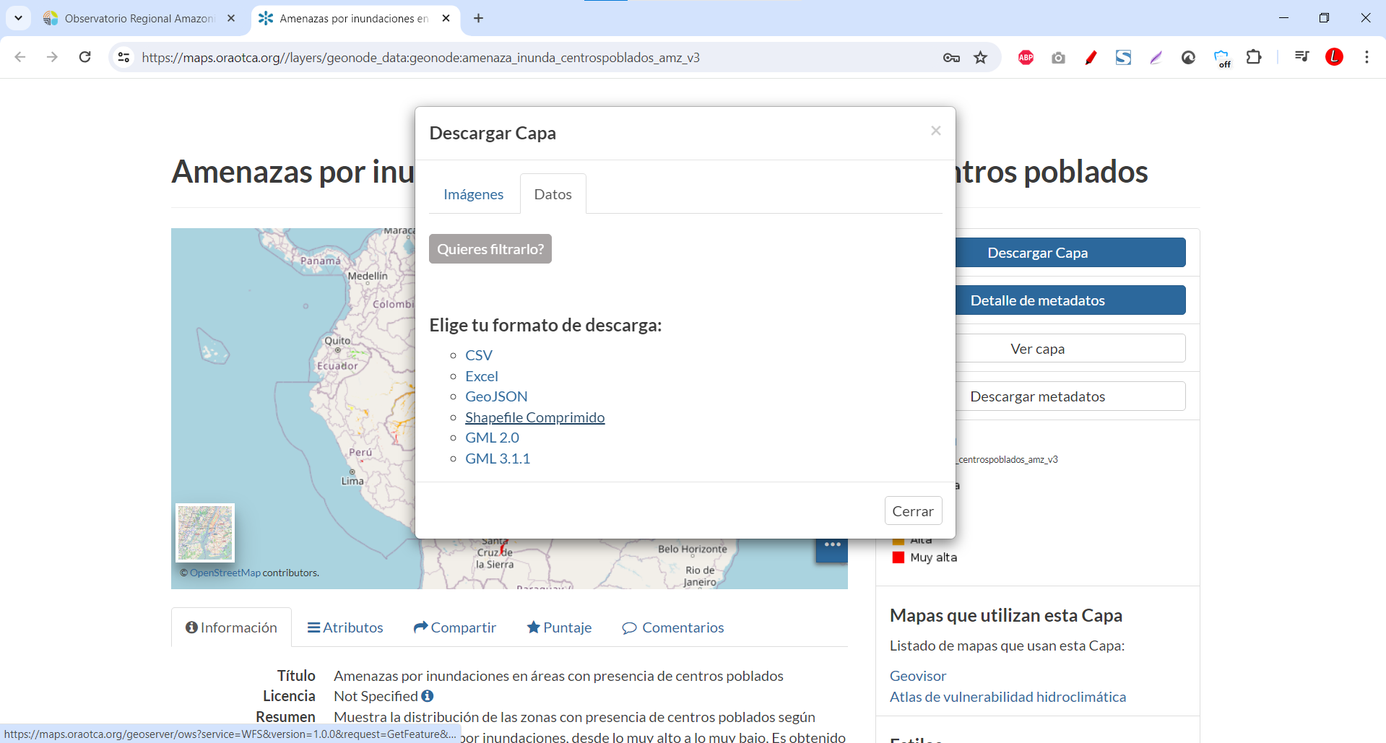
4
3
5

